Slide 1
A Performance Measure Framework for the Cost-Effectiveness of Medicare Provider Outreach and Education Activities
Luke Patterson
Notes:
Hello, and thank you for taking the time today to hear this presentation on my work developing A Performance Measure Framework for the Cost-Effectiveness of Medicare Provider Outreach and Education Activities

Slide 2
Background
Purpose of provider outreach and education (POE): Reduce overall CERT error rate
Done through education of provider staff
  Common claims errors
  Targeted outreach and training
  General education on aspects of Medicare
Can cover broad topics, target specific types of errors, or specific providers incurring errors
Notes:
Let’s start off with talking about what provider outreach and education (or POE) activities are. If you’re not aware, the purpose of provider outreach and education (POE): is to reduce improper payments and claim errors, measured by the reduction in the overall CERT error rate.
This is done through education of provider staff on:
How to avoid common claims errors
Targeted outreach and training to address specific errors
General education on aspects of Medicare
POE can cover broad topics of Medicare, target specific types of errors commonly made by the provider community, or specific providers incurring errors at an abnormal rate.

Slide 3
Background
Administered by Medicare Administrative Contractors (MACs) via many different modes, including:
  Web-based training sessions
  Help hotlines and Interactive Voice Response lines
  Face-to-face instruction
  Print and digital informational materials
  Presentations
  Podcasts
Little cost effectiveness and performance data is available.
Notes:
POE is administered by Medicare Administrative Contractors (MACs) via many different modes, including:
Web-based training sessions
Help hotlines and Interactive Voice Response lines
Face-to-face instruction
Print and digital informational materials
Presentations
Podcasts
MACs have discretion to offer POE based on data analysis from different kinds of error reports, provider requests, and other sources.
While qualitatively rich reporting data is available, little quantitative cost effectiveness and performance data is available.

Slide 4
Introduction
Purpose: Assess how to measure performance and cost effectiveness of POE activities.
Research Questions:
  How can performance and cost-effectiveness of MAC-provided outreach and education be quantifiably measured?
  What current feedback and monitoring systems are currently in place to measure outreach and education performance?
  What changes to data collection and reporting requirements can be made to the current system to allow for the construction of performance measures?
Notes:
This is where my study comes in. The purpose of my work this semester was to assess how to measure performance and cost effectiveness of POE activities. Specifically, my goal was to answer:
How can performance and cost-effectiveness of MAC-provided outreach and education be quantifiably measured?
What current feedback and monitoring systems are currently in place to measure outreach and education performance?
What changes to data collection and reporting requirements can be made to the current system to allow for the construction of performance measures?

Slide 5
Methodology
Gather data through:
  Interviews with CMS staff/MAC staff
  Literature review on similar public performance measurement efforts
  Document and data review of relevant POE materials
Apply and adapted recommendations from a project from my job to develop a performance measures framework for POE
Notes:
I gathered data through Gather data through:
Interviews with CMS staff/MAC staff from a selected MAC contractor
Literature review on similar public performance measurement efforts
Document and data review of relevant POE materials
From these data, I then applied and adapted recommendations from a project from my job to develop a performance measures framework for POE

Slide 6
POE Logic Model
Problem Specification
Program Theory/ Design
Inputs/ Activities
Outputs
Outcomes
Impacts
- Medical providers face a complex billing process for Medicare
- As a result, a considerable number of Medicare claims errors occur
- To prevent these errors, MACs provide POE to educate providers on avoiding errors
-MAC staff time
- MAC training resources
- Provider staff time
- POE facilitation technology (webinars, websites, hotlines, etc.)
-Number of training sessions held
-Number of materials produced/ material views
-Number of phone calls into IVR/CSRs
-Increased of knowledge of Medicare claim preparation and submission processes
-Increased ability to preemptively correct errors in claims
-Increased efficiency in submission of claims
-Decreased CERT error rates
-Decreased claims processing time
Notes:
From my data collection, I first constructed a logic model to fully map how POE is intended to work.
The problem POE attempts to address is that medical providers face a complex billing process for Medicare. As a result, a considerable number of Medicare claims errors occur.
MACs provide POE to educate providers on avoiding errors to prevent these claims errors from occurring. This education is provided via staff training time, training resources, and facilitation technology
Outputs from POE include:
-Number of training sessions held
-Number of materials produced/ material views
-Number of phone calls into IVR/CSRs
Expected outcomes from this training include: -Increased of knowledge of Medicare claim preparation and submission processes
-Increased ability to preemptively correct errors in claims
-Increased efficiency in submission of claims
With the overall expected impacts being -Decreased CERT error rates
-Decreased claims processing time

Slide 7
Data Collection Findings
MACs provide a wide range of activities.
Some POE activities target a wide range of providers, others only a single type/provider.
Decisions on what POE offerings are data-driven.
Individualized POE is the most desired, but also the most expensive.
MACs already possess some internal metrics and feedback systems
Literature review: Other government agencies have done this kind of performance measurement.
Notes:
From discussions with MAC staff, a number of very interesting findings came to light:
MACs provide a wide range of activities. As I mentioned previously, Web-based training sessions
Help hotlines and Interactive Voice Response lines
Face-to-face instruction
Print and digital informational materials
Presentations
Podcasts
POE activities have a wide range of purposes. Some POE activities target a wide range of providers, others only a single type/provider. Some give broad education on Medicare, others give specific guidance on a particular type of error.
Decisions on what POE offerings are data-driven from MACs through looking at . MACs have discretion to offer POE based on data analysis from different kinds of error reports, provider requests, and other sources.
Individualized POE is the most desired by providers, but also the most expensive for MACs to give.
MACs already possess some internal metrics and feedback systems to assess the performance and effectiveness of POE, and are regularly assessing how they can better deliver. This foundation of internal process improvement and tracking will help CMS standardize and implement performance measures.
Finally, through my literature review, I identified that a number of other agencies have implemented similar performance measures in the past, and that lessons learned from those may be useful for CMS to consider. A couple examples.
The U.S. Department of Labor conducted a feasibility study of its technical assistance (TA) to its grantees and other supporting organizations (which I was a part of). One of the primary things identified was the importance of ensuring those who were being measured understood how they were being measured, and what the implications or consequences of that measurement were.
The role of technical assistance was measured in an evaluation of the U.S. Department of Education’s Healthy Schools Program. The authors found that quantifying the “dosage” of TA is another way to measure the effectiveness of TA via performance measures

Slide 8
POE Performance Measure Framework
POE falls into the broader category of technical assistance (TA):
  “Technical assistance is the process of providing targeted support to an organization with a development need or problem.” – Fixson et al (2005)
Adapted TA performance measures framework from a project from my job for U.S. Department of Labor. 7 steps:
  Identify the TA initiatives to be measured.
  Identify the desired outcomes of TA initiative(s)
  Translate outcomes into cost effectiveness performance measures
  Develop a baseline and target for each performance measure
  Pilot-test and refine the performance measures
  Implement performance measures at full-scale
  Monitor TA initiative’s performance measures to assess whether targets have been met
Notes:
Based on my data collection findings, I developed a performance measure framework for POE activities, and developed several example performance measures to demonstrate how it could be applied. I chose to adapt this framework from the DOL study I was a part of because of the similarity of activities between POE and DOL’s. Both fall under the category of technical assistance: “the process of providing targeted support to an organization with a development need or problem”
My framework has seven steps to develop performance measures for a given kind of POE activity:
Identify the TA initiatives to be measured.
Identify the desired outcomes of TA initiative(s)
Translate outcomes into cost effectiveness performance measures
Develop a baseline and target for each performance measure
Pilot-test and refine the performance measures
Implement performance measures at full-scale
Monitor TA initiative’s performance measures to assess whether targets have been met

Slide 9
Cost Effectiveness
Divide outcome in performance measure by cost of activities
  [X number of outcomes] were achieved per dollar spent on related POE activities
May require more specific billing procedures for the cost of MAC POE activities
Notes:
Cost effectiveness of each performance measure can be obtained by dividing the cost of activities associated with the performance measure.
Cost effectiveness requires that costs be able to be tied to very specific activities, and may require additional billing procedures.

Slide 10
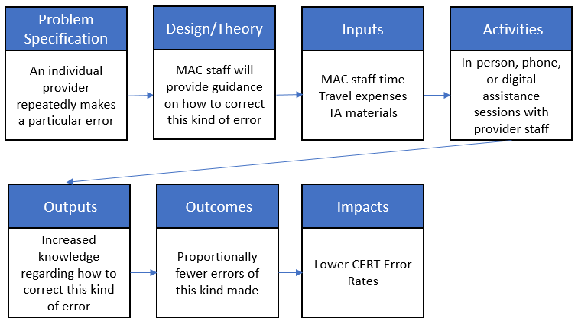
POE Performance Measure Examples
Provider-specific POE activities
Notes:
A common type of POE administered is individual, provider-specific POE support. These instances often arise when individual providers are struggling with a particular kind of claims error.
Walk though logic model

Slide 11
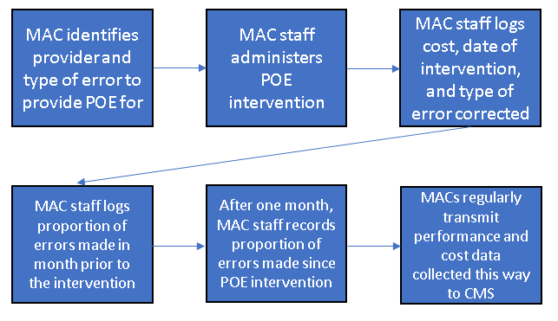
POE Performance Measure Examples
Provider-specific POE activities
  Example PM: For each MAC, average reduction in proportion of prescribed errors made by providers in the month after receiving targeted POE training compared to the month prior.
Notes:
As a note, time frames in the examples are arbitrary; month could be quarter or other unit of measurement if more applicable.

Slide 12
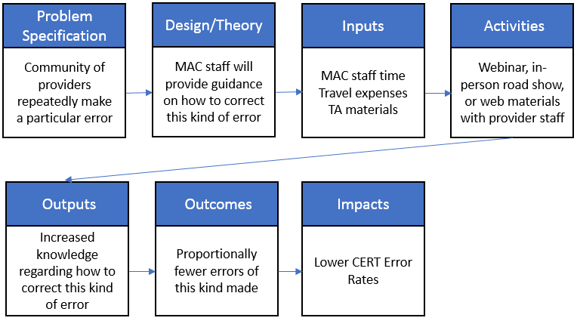
POE Performance Measure Examples
General POE for a Specific Error
Notes:
POE outreach to address a particular error does not always target a single provider. This second example is similar to the first example in several ways, but covers how to develop a performance measure for POE outreach that seeks to target a specific error that is occurring in the general provider population.

Slide 13
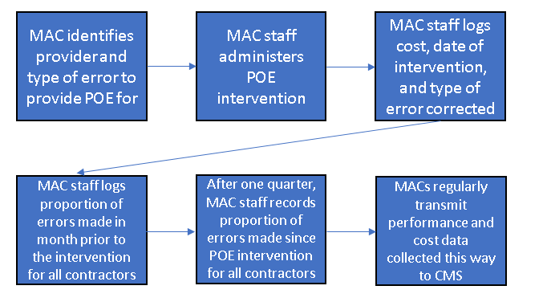
POE Performance Measure Examples
General POE for a Specific Error
  Example PM: Average reduction in proportion of prescribed errors made by the MAC’s community of providers in the quarter after receiving targeted POE training compared to the quarter prior.

Slide 14
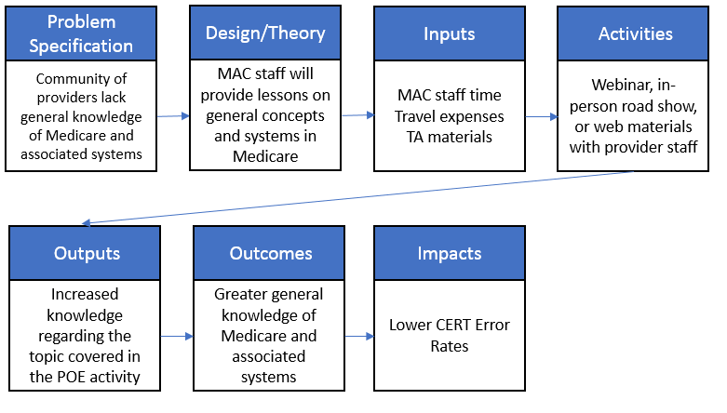
POE Performance Measure Examples
Broad Topic POE Activities
Notes:
MACs frequently conduct webinars and live shows for providers to educate them on broader topics than simply correcting individual errors, such as what the CERT error rate is, why accuracy in claims matters, and general updates to Medicare billing policy.
Less specific, can be a post-webinar survey. MACs typically do this already.

Slide 15
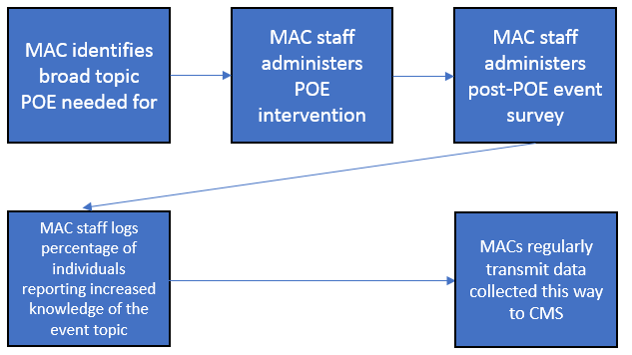
POE Performance Measure Examples
Broad Topic POE Activities
  Example PM: Total percentage of broad-topic consumers this month reporting increased knowledge of the targeted topic immediately after the POE activity.

Slide 16
Conclusions
Many pieces needed for performance measurement are present:
  MACs likely collect performance data for internal purposes
  MACs already provide detailed reporting
  Several kinds of POE (though not all) are well-suited for performance measurement
Possible next steps for CMS:
  Start small with quantifying outputs in a standard fashion
  Further discussions with MACs to identify activities for trial performance measurement
  [Down the road] Conduct formal evaluation of POE activities

Slide 17
Questions/Thank You!

Slide 18
References
U.S. Department of Labor, Employment and Training Administration. (2017), unpublished. Technical Assistance Evaluation and Feasibility Study: Final Report. Washington, DC: Chamberlain, A., Kracker Selzer, A., Patterson, L.
Fixson, Dean, Sandra Naoom, Karen Blase, Robert Friedman, and Frances Wallace. Implementation Research: A Synthesis of the Literature. Tampa, FL: Louis de la Parte Florida Mental Health Institute, 2005. http://www.fpg.unc.edu/~nirn/resources/ publications/Monograph

